Slide 1

SPAM CLASSIFIER
19RH1A05E0
19RH1A05E3
19RH1A05E9
II CSE C

Slide 2

INTRODUCTION
Every day we get dozens and hundreds of mails and most of them are spam.
According to stats we receive 40% of spam mails daily where we exclude social and promotional mails.
In recent times, unwanted commercial bulk emails called spam has become a huge problem on the internet.

Slide 3
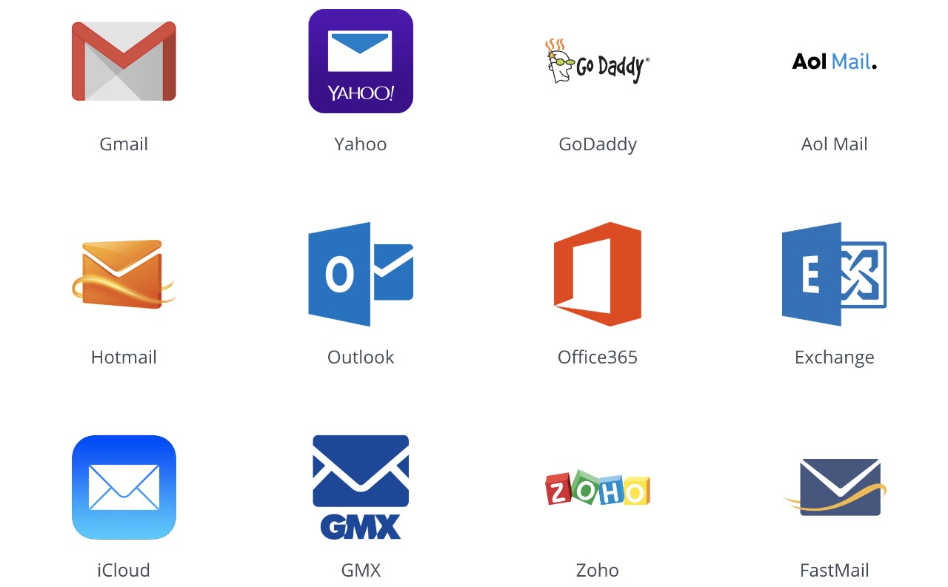
TYPES OF MAILS
Google email
Yahoo
Office 365
Outlook
Exchange
Hot mail
live

Slide 4
PROBLEM
SOLUTION
Spam emails can be annoying for users, but they bring more issues and risks with them.
To effectively handle the threat posed by email spams, leading email providers have employed the combination of different machine learning (ML) techniques.

Slide 5
MODEL OVERVIEW
EDA (Exploratory data analysis)
Data Preprocessing
Feature Extraction
Scoring & Metrics
Improvement by using Embedding + Neural Network
Comparison of ML algorithm & Deep Learning

Slide 6
HOW IT CLASSIFIED
Text Processing
Text Sequencing
Model Selection
Implementation
Performance Metrics

Slide 7
Factors For Classifying Mails
Mail sender
Content of Mail
Subject of Mail
Received Time of Mail

Slide 8
Technology Used
Natural Language Processing
Deep Learning
Supervised Machine Learning
Python

Slide 9
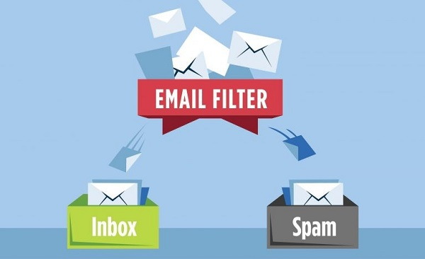
Anti-spam Filtering Techniques
Spam Filtering by Content
Use Contact Forms
Blacklisting Certain
Avoid Posting Your Email ID Publicly in the Internet
Avoid Posting Your Email ID Publicly i the Internet
Use Contact Forms

Slide 10

ADVANTAGES
Time saving
Automatic Filtration
Confidential Information
Sorted Order

Slide 11

Future Works
More Accurate Detection
Spam Detection in Real Time
Efficient Anti spam filter
Efficient Algorithm

Slide 12

THANK YOU

